Slide 1


Slide 2


COMPANY OVERVIEW
AMD (Advanced Micro Devices), founded in 1969, is a global leader in high-performance and adaptive computing.
Headquartered in Santa Clara, USA, it designs cutting-edge CPUs, GPUs, SoCs, and AI accelerators.
Known for flagship products: Ryzen™, Radeon™, EPYC™, and Instinct™.
Gained competitive edge with Zen architecture in 2017, reversing years of Intel dominance.
Acquired Xilinx (adaptive computing) and Pensando (networking), strengthening its AI and data center portfolio.
Powers top gaming consoles like PS5 and Xbox Series X with custom silicon.
Among the top 3 global chipmakers by performance, efficiency, and innovation in 2025. Aggressively expanding in AI, HPC, and cloud infrastructure markets.

Slide 3











1969
1982
2003
AMD founded in California
Partners with Intel to become second-source for x86 CPUs
Launches AMD64 – first 64-bit x86 processor
TIMELINE
AMD Timeline – Key Milestones
2018
2017
2006
Launches EPYC server CPUs, challenges Intel in data centers2020: Powers PS5 & Xbox Series X with custom SoCs
Releases Ryzen CPUs (Zen architecture) – major comeback in desktop market
Acquires ATI Technologies, enters GPU market
2022
2023
2024–2025
Acquires Xilinx, enters adaptive computing & AI markets
Launches Ryzen 7000 & EPYC Genoa, leads in efficiency & core counts
Expands presence in AI, HPC, and data centre accelerators

Slide 4
PRICING CHARTS
Segment | Model 1 | Prices | Model 2 | Prices
Server / Data Center | EPYC 9654 | $11,805 | EPYC 8534P | $4,950
Workstation / HEDT | Threadripper PRO 7995WX | $10,000 | Threadripper 7970X | $2,499
Desktop – High-End / Gaming | Ryzen 9 9950X | $649 | Ryzen 7 9800X3D | $472
Desktop – Midrange | Ryzen 7 9700X | $318 | Ryzen 5 9600X | $240
Desktop – Entry-Level | Ryzen 3 4100 | $99 | Athlon 3000G | $49
Mobile – High-End | Ryzen 9 9955HX3D | $650 | Ryzen 9 8945HS | $650
Mobile – Mainstream | Ryzen 5 8645HS | $350 | Ryzen 3 7330U | $250
Mobile – Entry/Low Power | Ryzen Z1 | $200 | Athlon Silver 7120U | $100

Slide 5
MARKET SHARE
Segment | 2024 Q1 Unit Share | 2024 Q1 Revenue Share | 2023 Q4 Unit Share | 2023 Q4 Revenue Share | 2023 Q1 Unit Share | 2023 Q1 Revenue Share | Q/Q Unit Change | Y/Y Unit Change | Q/Q Revenue Change | Y/Y Revenue Change
Server | 23.60% | 33.00% | 23.10% | 31.80% | 18.00% | 27.80% | 0.5 | 5.6 | 1.2 | 5.2
Desktop | 23.90% | 19.20% | 19.80% | 15.90% | 19.20% | 15.40% | 4.1 | 4.7 | 3.3 | 3.8
Mobile | 19.30% | 14.90% | 20.30% | 15.00% | 16.20% | 10.90% | -1 | 3.1 | -0.1 | 4
Total Client | 20.60% | 16.30% | 20.20% | 15.40% | 17.00% | 12.50% | 0.4 | 3.6 | 1 | 3.8
At a Glance: 2025 CPU Market Overview
Market Position: AMD ranks #2 globally in x86 CPUs with a 24.7% share, vs. Intel's 72.9% share.
Growth Engines: 57% YoY surge in data center revenue, especially from EPYC and AI-optimized CPUs.
Revenue Snapshot: $7.4B revenue in Q1 2025, a strong +36% YoY growth.
Competitive Context: While AMD leads in DIY and is gaining in servers, Intel dominates overall with deep OEM channels and mobile PC control.
Intel faces ~$1.3B YoY revenue decline, pressured by AMD's gains in data center and high-performance markets

Slide 6
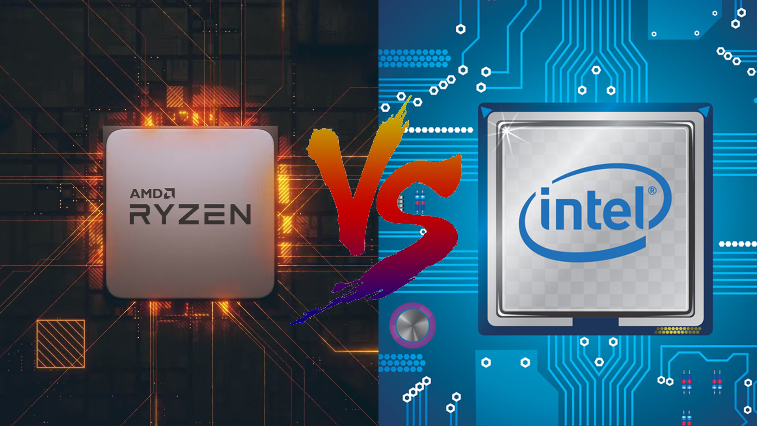

Slide 7
Company Comparison – AMD vs Intel
Aspect | AMD | Intel
Founded | 1969 | 1968
Business Model | Fabless – relies on TSMC for chip production | IDM (Integrated Device Manufacturer) – owns fabs
Employees | ~25,000 | ~130,000
Revenue (2024) | $23.5B | $58.4B
CPU Strategy | High core count, better perf/watt, aggressive pricing | Strong single-thread, AI integration, deep OEM ties
Product Branding | Ryzen (consumer), EPYC (enterprise) | Core (consumer), Xeon (enterprise)
Market Focus | Cloud, gaming, high-efficiency compute | Enterprise, mobile, AI PCs, large-scale OEMs

Slide 8
B2B Product Comparison – AMD EPYC vs Intel Xeon (2025)
Metric | AMD EPYC 9004 Series | Intel Xeon 5th Gen (Emerald Rapids)
Max Cores / Threads | Up to 128C / 256T (EPYC Bergamo) | Up to 64C / 128T
Process Node | TSMC 5nm (N5) | Intel 7 (10nm Enhanced SuperFin)
TDP Range | 200W – 400W | 185W – 350W
Perf/Watt | Leading efficiency in multi-core workloads | Optimized with DSA (Data Streaming Accelerator), AMX
Memory Channels | 12-channel DDR5 | 8-channel DDR5
PCIe Lanes | Up to 160 lanes (PCIe Gen 5) | Up to 80 lanes (PCIe Gen 5)
Security Features | SEV-SNP, Secure Boot, Full Memory Encryption | SGX, TDX, AMX for AI acceleration & secure enclaves
Deployment Partners | AWS, Microsoft Azure, Meta, Oracle | Google Cloud, AWS, IBM, HPE, Dell
Average Price (per CPU) | $4,000 – $11,000 (varies by core count & TDP) | $2,500 – $10,000 (based on SKU and features)

Slide 9
B2C Product Comparison – AMD Ryzen vs Intel Core
Metric | AMD Ryzen 7000/8000 Series | Intel Core 14th Gen (Raptor Lake Refresh)
Top SKU | Ryzen 9 7950X / Ryzen AI 9 HX 370 | Core i9-14900K / Core Ultra 9
Core Architecture | Zen 4 / Zen 5 | Raptor Lake / Meteor Lake (Hybrid x86)
Process Node | 5nm (TSMC) | Intel 7 (10nm class)
Integrated Graphics | RDNA 3 (select models), high iGPU perf | Intel Iris Xe / Arc iGPU (better AI integration)
AI Capability | Ryzen AI NPU (AI PCs ready) | Core Ultra series with integrated NPU
Overclocking | Supported via Ryzen Master | Supported via Intel XTU
TDP Range | 65W–170W | 65W–253W
OEM Presence | Present in ASUS, Lenovo, Acer | Dominant across Dell, HP, Lenovo, others

Slide 10





4P MODEL
PRODUCT
PLACE
Desktop CPUs: Ryzen X and F series tailored for gamers, creators, and mainstream users across Ryzen 3, 5, 7, and 9 tiers.
Server CPUs: EPYC 9004 (Genoa/Genoa-X) for cloud/data centers
Mobile CPUs: Ryzen H ,HS, U & Ryzen AI 300 Series targeting ultra-thin, gaming, and AI laptops.
Software Ecosystem: Ryzen AI with integrated NPU (Neural Processing Unit), AMD PRO Technologies and compatibility with major OSs and frameworks.
Direct: Partnered with major cloud providers (AWS, Azure, Meta) for EPYC CPU deployments in AI, compute, and storage workloads.
OEMs: HP, Dell, Lenovo, Acer integrating Ryzen CPUs across business, education, and gaming laptops.
Retail/DIY: High availability via Amazon, Best Buy, Newegg; socket AM4,AM5 platform promotes upgradeability and customer retention.
PRICE
PROMOTION
Desktop: Ryzen CPUs priced ~15–20% lower than comparable Intel Core i5/i7/i9 chips, especially attractive in DIY and budget gaming markets.
Server: EPYC offers better total cost of ownership (TCO) via higher core density and lower perf/watt costs, especially vs. Intel Xeon.
Mobile: Competitive pricing vs. Intel Core Ultra and H-series chips; value focus in entry-level gaming and business segments.
Events: "Advancing AI" and “Data Center Tech Day” events showcasing Ryzen and EPYC innovations.
Content Strategy: Technical whitepapers, developer blogs, and performance comparison videos highlighting real-world advantages.
B2B Engagement: LinkedIn thought leadership, webinars with cloud/data center architects.
Community: Strong grassroots support in the DIY PC community through YouTube, Reddit, and forums (e.g., r/AMD).
Notes:
H – high performance, HS – highest possible performance, U - battery saver, X – higher clock speed, F – w/o integrated GPU

Slide 11
STRENGHT
OPPORTUNITIES
Diversified CPU portfolio: Ryzen and EPYC address broad market verticals
Superior performance-per-watt, core density, and scalable architecture (Zen 4/5) vs. peers
Strong presence in hyperscaler adoption.
Leverages AM5 socket longevity to reduce upgrade friction and enhance platform stickiness
S
O
Rising demand for AI-accelerated mob
Capitalize on x86 cloud migration with tailored EPYC SKUs for AI, compute, and storage workloads
Strengthen ecosystem through open software stack alignment
Vertical growth via enterprise partnerships and OEM custom solutions
WEAKNESS
THREAT
Limited penetration in enterprise-grade mobile OEM platforms vs. Intel Core Ultra
Underutilized AI-NPU integration messaging, reducing visibility in the emerging AI PC segment
Weaker global supply chain control due to full reliance on TSMC for advanced node manufacturing
Brand perception lags in business-class and government procurement cycles
W
T
Intel’s strategic alignment of fabs + design (IDM 2.0) poses long-term integration threat
Price pressure due to competitive bundling and subsidies in the mobile and enterprise segment
Potential delays or constraints at TSMC 3nm/4nm nodes, creating risk in roadmap execution
Emergence of ARM-based CPU competitors
Notes:
Theek leave

Slide 12




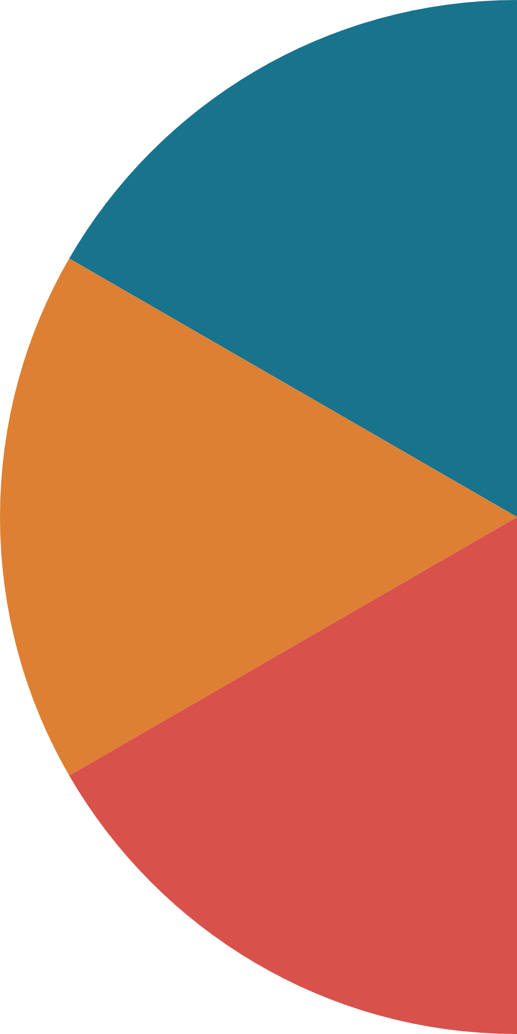







PESTLE ANALYSIS
1
4
Political
Technological
US export controls limit CPU expansion in Asia.
EPYC deployments subject to US regulatory scrutiny in sensitive sectors.
AI growth drives need for NPUs and accelerator-ready CPUs.
Roadmap depends on Zen execution and TSMC node access.
2
5
Economic
PESTLE
Legal
Cloud and enterprise demand tied to macroeconomic cycles.
Strong USD reduces global pricing flexibility for Ryzen.
ANALYSIS
Faces global antitrust and IP compliance challenges.
x86 product continuity relies on Intel cross-licensing.
3
6
Social
Environmental
Hybrid work drives mobile CPU demand.
DIY users seek efficiency, value, and long-term upgrade paths.
EPYC aligns with green data center goals.
Fabless model supports AMD’s low-emission ESG profile.

Slide 13


Slide 14


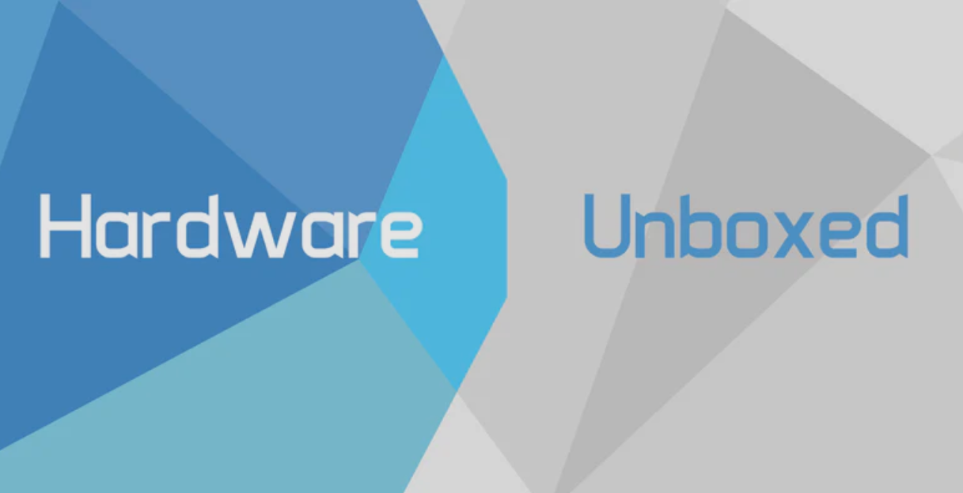


1. Technical Influencer & Thought Leadership Marketing
Business Focus:
Data-backed marketing via influencers (Linus Tech Tips, Gamers Nexus, Hardware Unboxed)
Focus on benchmarks, thermal efficiency, and cost-per-core
Builds trust through third-party validation
Targets gamers, creators, and PC enthusiasts
Enterprise Strategy:
Uses LinkedIn, CIO briefings, and webinars for outreach
Highlights efficiency, scalability, and total cost of ownership
Supports messaging with whitepapers and case studies
Targets hyperscalers and data center clients

Slide 15











2. PRICING DONE RIGHT!
Value-Driven
Prices set lower than Intel for better performance-per-dollar.
Tiered Structure
Ryzen 3 to 9 and EPYC SKUs target different performance segments.
Competitive Undercut
~10–20% cheaper than Intel at similar specs to attract switchers.
OEM & Bundle Deals
Discounts to partners and bundled pricing boost adoption.
Adaptive Pricing
Dynamic response to market launches, regions, and demand shifts.

Slide 16
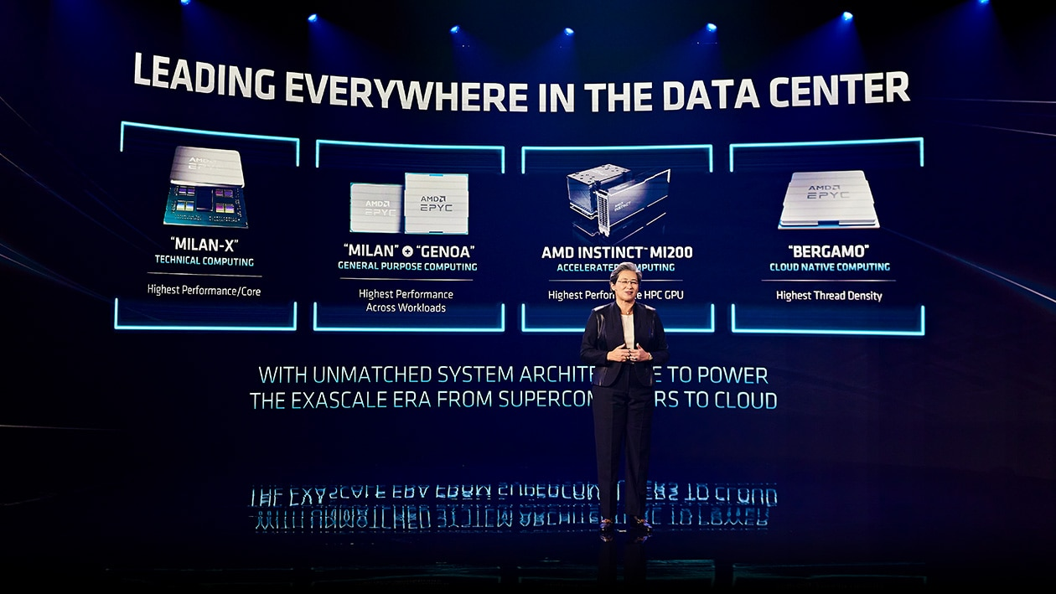
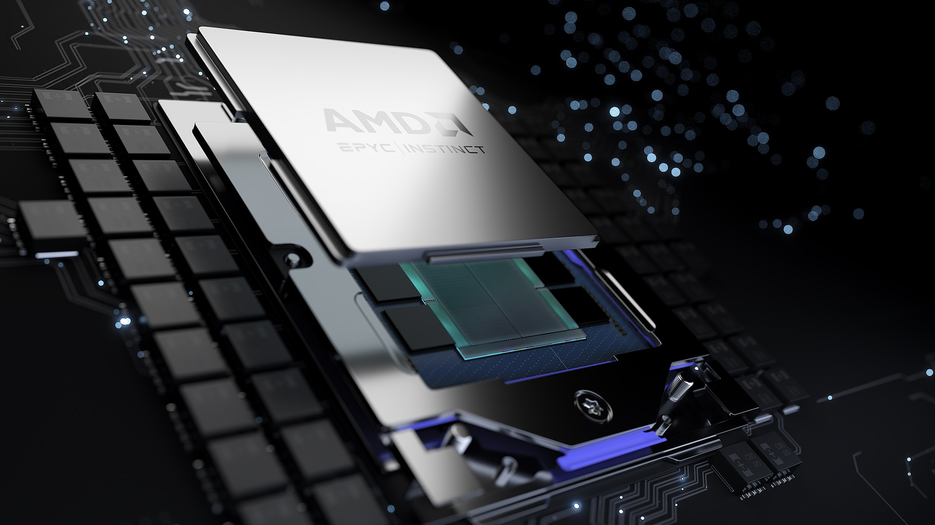
2. Data-Centric Campaign Storytelling
Business Focus:
Campaigns like "Together We Advance" and "Data Center Tech Day" highlight how AMD CPUs deliver quantifiable performance gains:
Lower total cost of ownership (TCO) with EPYC
Higher throughput per watt
AI-readiness with integrated NPUs in Ryzen AI series
AMD also presents real-world case studies using EPYC in cloud workloads (Meta, AWS), helping buyers make ROI-backed decisions.

Slide 17

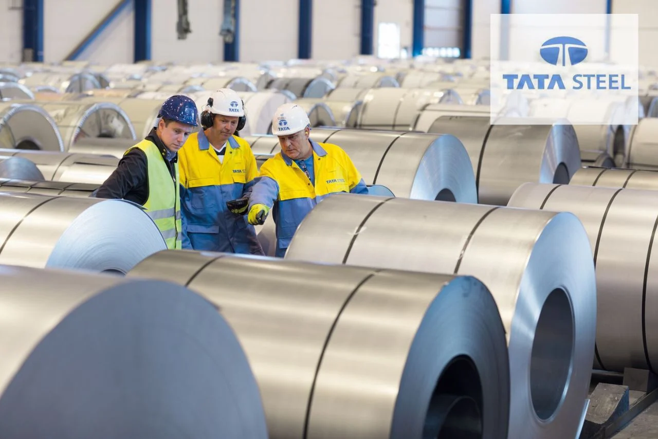
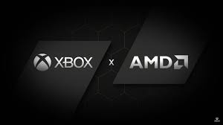
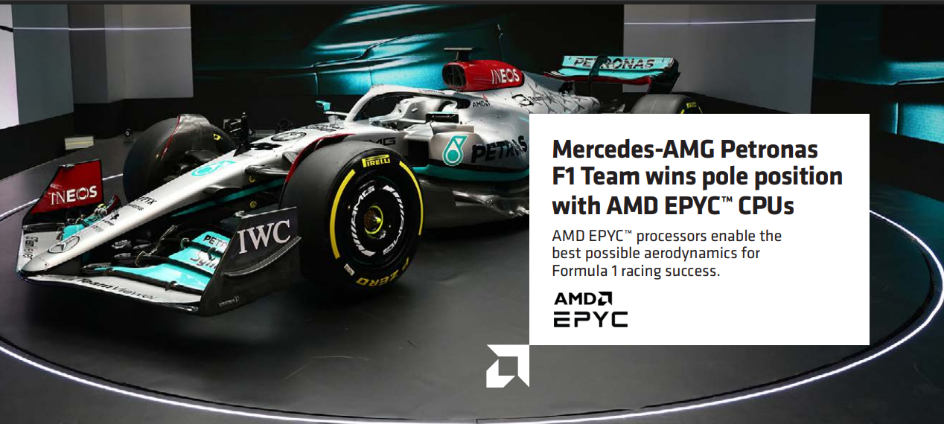
3. Moment Marketing & Strategic Partnerships
– Institutionalizing Knowledge Sharing
AMD aligns product drops and partnerships with high-visibility moments:
Game launches, hardware summits, and AI expos
Strategic OEM alliances with Dell, Lenovo, HP to co-market Ryzen/EPYC systems
Esports & developer events drive emotional and performance-based branding
This creates a dual impact: consumer engagement and enterprise trust-building.

Slide 18
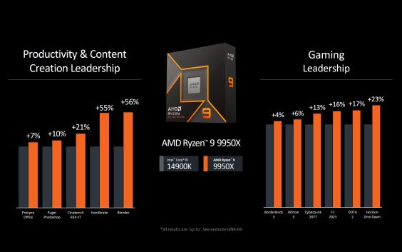
4. ROI & Benchmark-Oriented Positioning
Performance Leadership - Ryzen™ 9 9950X leads with +56% in Blender, +55% in Handbrake, and +21% in Cinebench R24 nT vs Intel i9-14900K—ideal for creators needing high throughput.
Gaming ROI - Delivers up to +23% FPS uplift in AAA titles (e.g., +17% in DOTA 2, +23% in Horizon Zero Dawn), offering superior FPS per dollar for gamers.
Value Optimization - Combines high perf/$ and perf/watt—key metrics for both enterprise buyers and DIY users focused on TCO and efficiency.
Market Messaging - AMD positions Ryzen not just as fast—but as a smart investment, backed by real-world benchmarks.

Slide 19
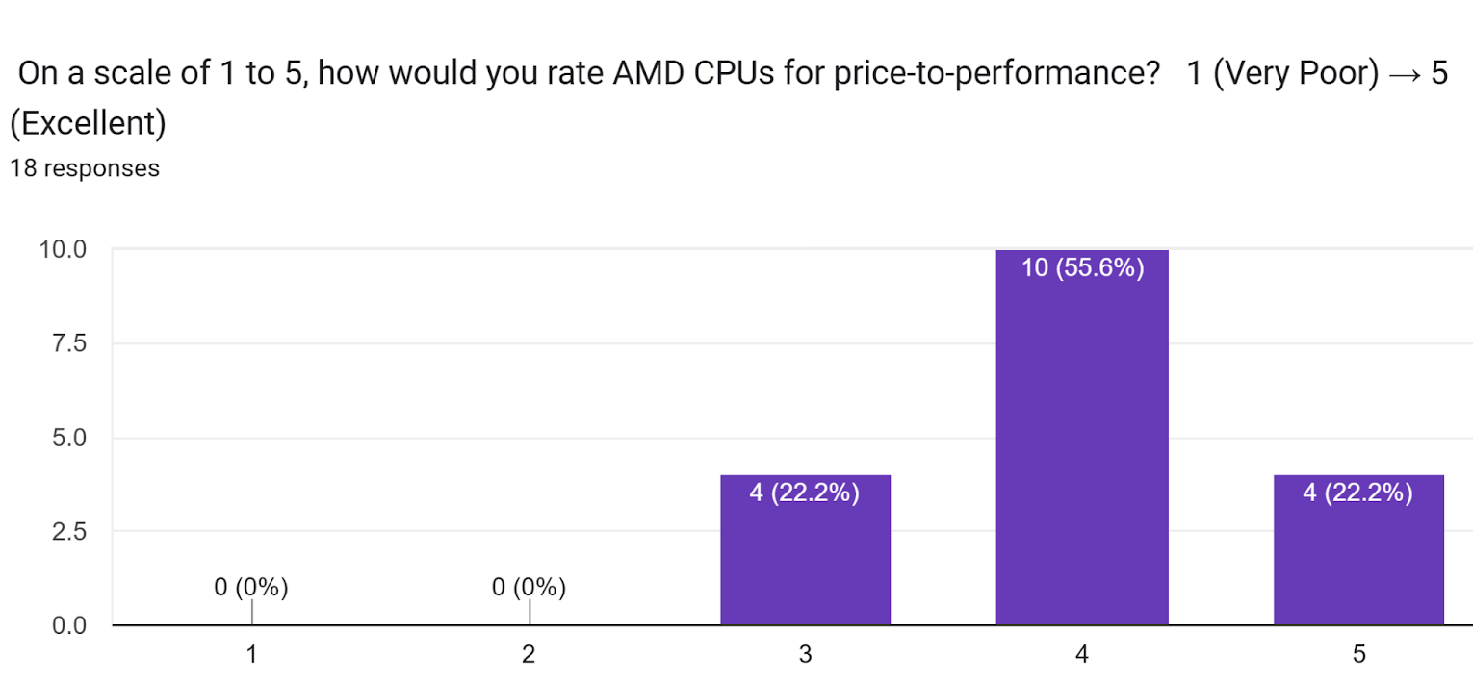
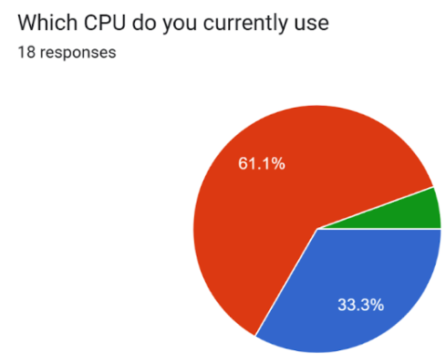

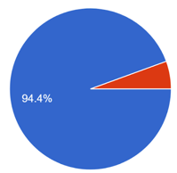
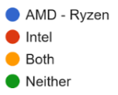
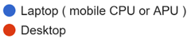
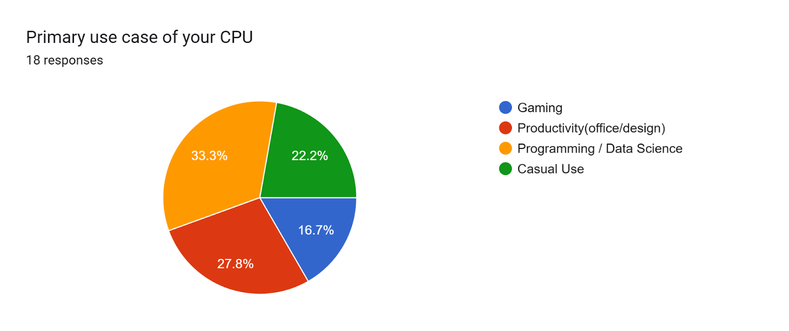
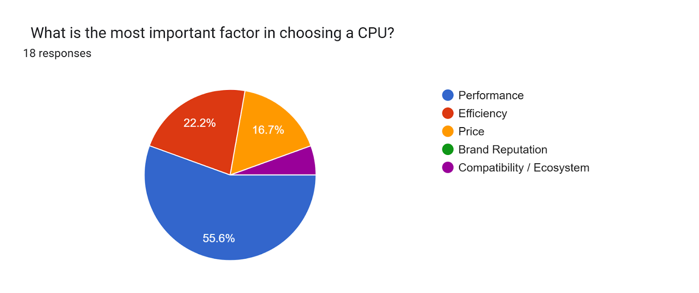
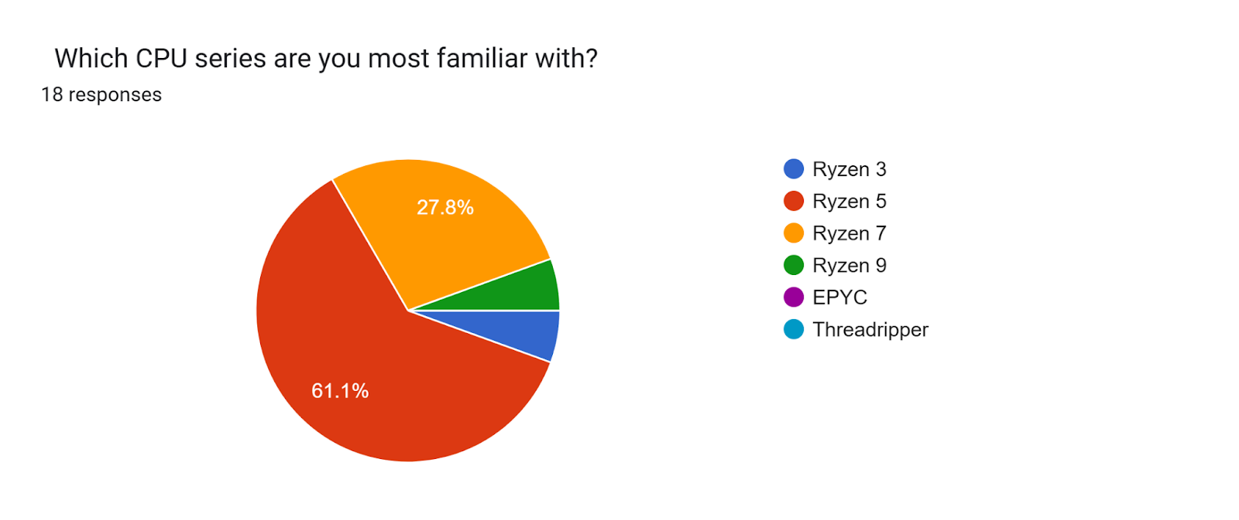
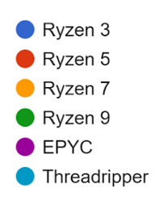
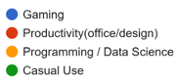
GFORM SURVEY

Slide 20
REVIEW
Consumer Behavior Analysis
Intel was preferred by 56% of respondents, especially in Programming/Data Science and Productivity categories.
Primary reason: Brand familiarity and perceived stability in performance.
However, Performance was cited as the top factor by most Intel users—despite Ryzen offering comparable or better performance at the same price in many segments.
Ryzen was chosen by 39%, predominantly by those who emphasized Performance, Price, and Gaming needs.
This group showed a more value-driven and performance-aware decision-making process.
Interestingly, Ryzen 5 and Ryzen 7 were the dominant choices—aligning with AMD's sweet spot for mobile CPUs in mid-range and high-efficiency segments.
Insight Gap: Among students who chose Intel and cited "Price" or "Efficiency" as deciding factors, there's a notable information asymmetry—indicating potential gaps in understanding AMD’s performance-per-price advantage, especially in mobile APU segments.
Strategic Implication
AMD’s brand perception still trails Intel in academic segments, despite offering a superior value proposition in performance/price efficiency, especially for laptops. The data indicates Intel’s edge is perceptual, not technical—driven by inertia and marketing. There's a clear opportunity for AMD to educate student buyers on TDP efficiency, core/thread advantage, and APU graphics performance to close this perception gap.

Slide 21

"In a market driven by perception, performance still speaks loudest."
THANK YOU!
Brains behind the bytes.
- Mansimar Singh (2K22/EP/059) & Gaurav Kapoor (2K22/EC/099)

